Slide 1
Convolution Reverb:
Impulse responses of spaces
Katya Soltan and Anisha Nakagawa

Slide 2
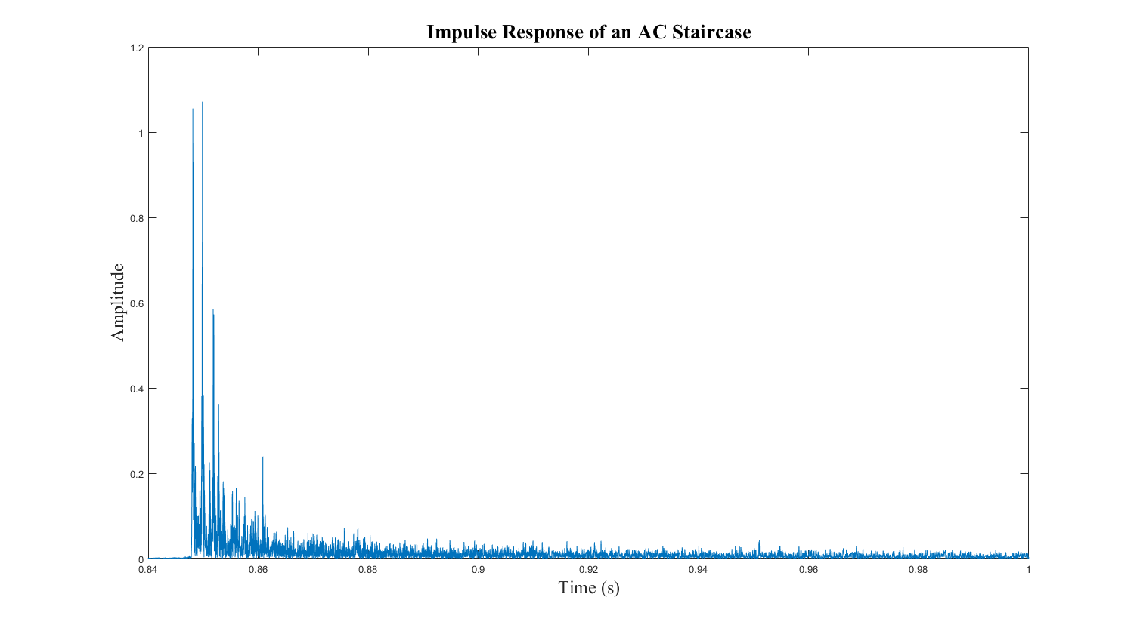
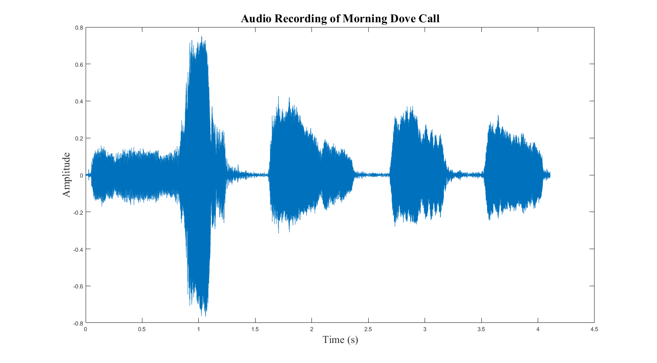
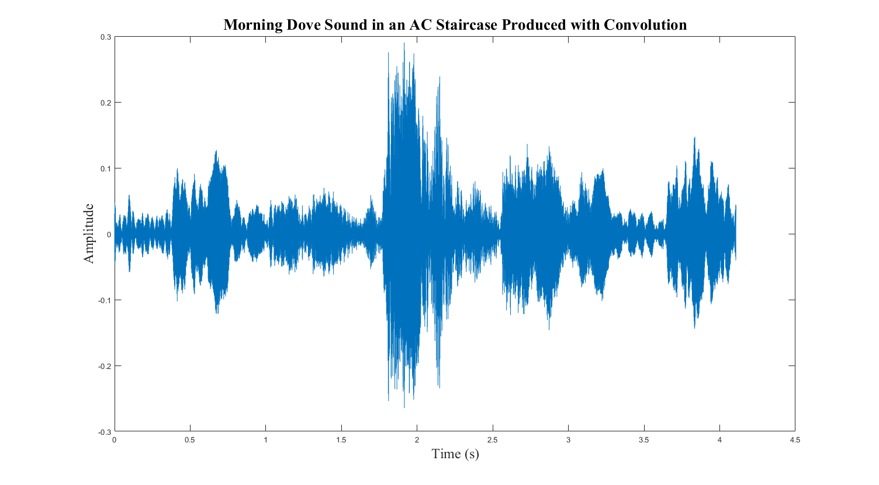
Dove in the AC Staircase
=
Impulse Response
of a staircase
*
Dove
Call
Dove in a staircase

Slide 3

System Diagram
Finding the Impulse Response
Convolving with Sound
Input
Impulse Response
of the Space
Recording
x(t)
h(t)
y(t)
h(t) * s(t) = s’(t)
-1
Impulse
Response
Original
Sound
Sound in the space
Y(jw)
X(jw)
H(jw) =
Y(jw)
X(jw)

Slide 4
Part 1: Find the Impulse Response

Slide 5
Generating Impulse Responses: Instantaneous Sound
Input: Impulse
Impulse Response
of the Space
Output: Impulse Response
x(t)
h(t)
y(t) = h(t)
Ex. clap, gunshot
Downsides
You can’t make an ideal impulse
Susceptible to noise

Slide 6
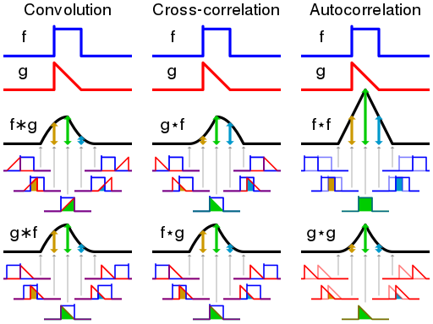
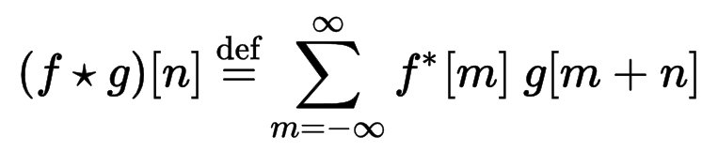
Generating Impulse Responses: White Noise
Cross-correlation of white noise to create an impulse
Cross-correlation
Measure of how similar two signals are based on displacement
Sliding dot product

Slide 7
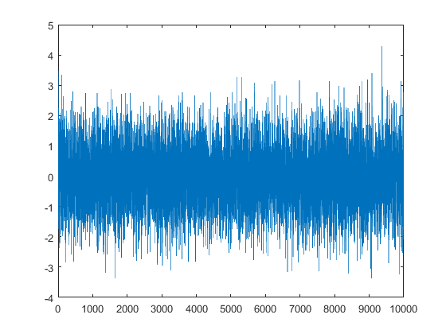
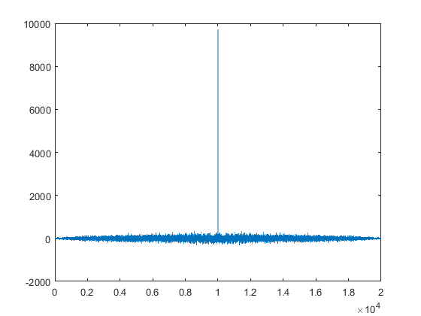
Generating Impulse Responses: White Noise
Cross-correlation of white noise to create an impulse
Cross-correlation of White Noise
White Noise: no similarity except for when signals are exactly lined up
White Noise
White Noise
Impulse
=
Amplitude
Amplitude
Amplitude
Time
Time
Time

Slide 8
Generating Impulse Responses: White Noise
Cross-correlation of white noise to create an impulse
Cross-correlation of White Noise
White Noise: no similarity except for when signals are exactly lined up
Downsides
Very noisy results
h(t) = R_{YX} / R_{XX}
Impulse Response
Output & Input
Input & Input

Slide 9

Generating Impulse Responses: Sine Sweep
“Chirp:” Sweep through all the frequencies
Chirp
20Hz - 20kHz
Impulse Response
of the Space
Recording
x(t)
h(t)
y(t)
-1
Y(jw)
X(jw)
H(jw) =
Y(jw)
X(jw)
Notes:
Insert of chirp

Slide 10
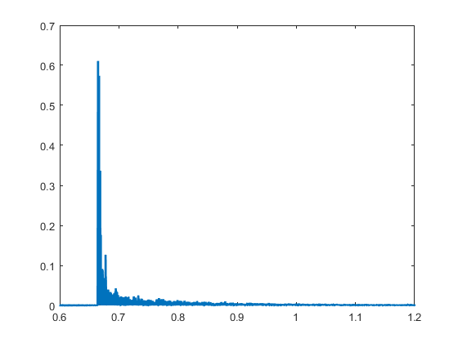
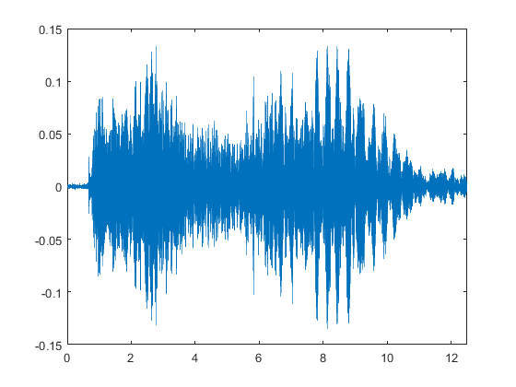
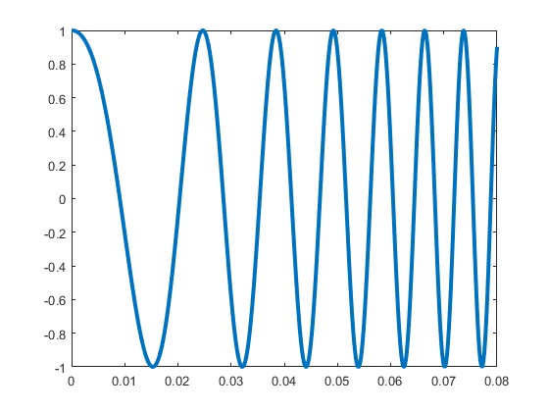
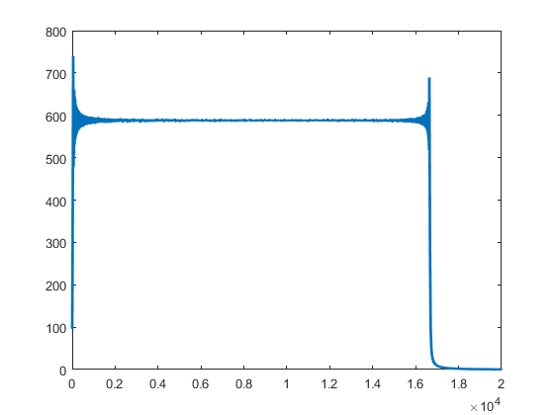
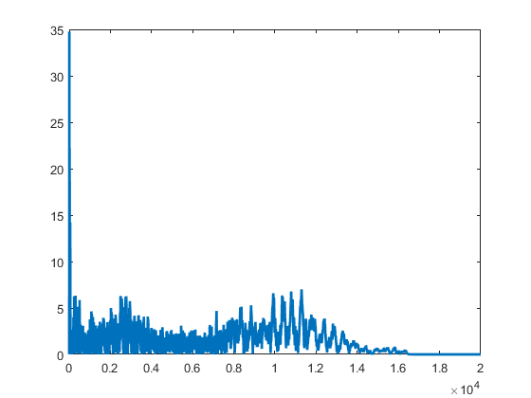
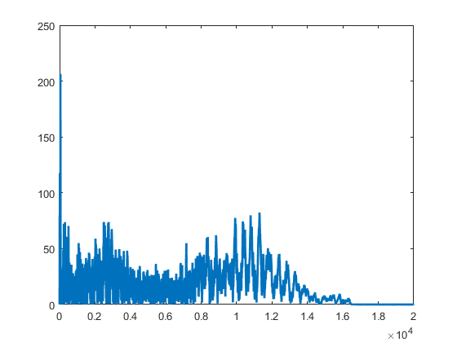
x(t) = Chirp
h(t) = Impulse Response
y(t) = Recording
Amplitude
Amplitude
Amplitude
Time (s)
Time (s)
Time (s)
-1
X(jw) = F{chirp}
H(jw) = Y(jw)/X(jw)
Y(jw) = F{recording}
Amplitude
Amplitude
Amplitude
Frequency (Hz)
Frequency (Hz)
Frequency (Hz)
Notes:
Insert of chirp

Slide 11
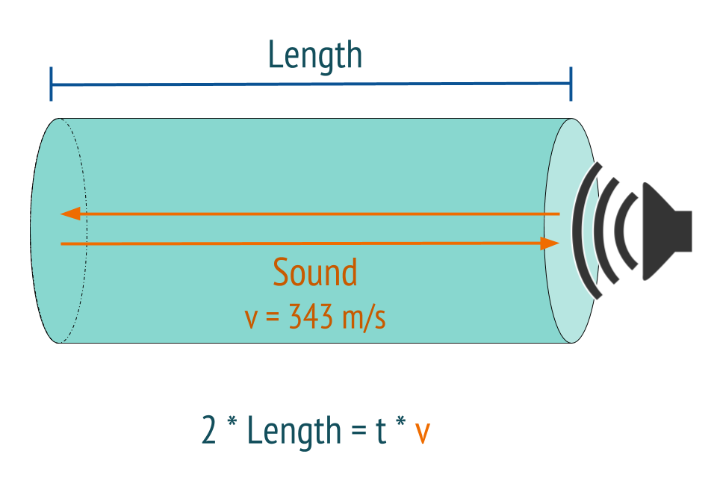
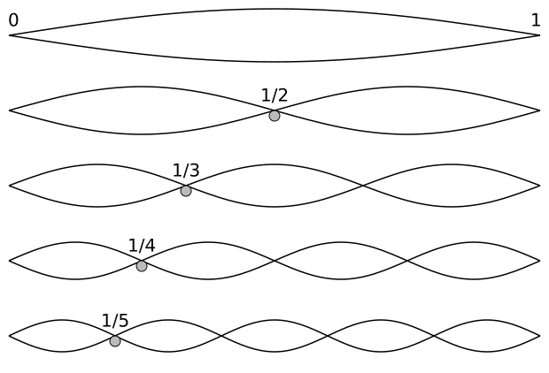
Understanding the Impulse Responses: Tubes
Sound must travel at least twice the length of the tube
Vibration Modes

Slide 12
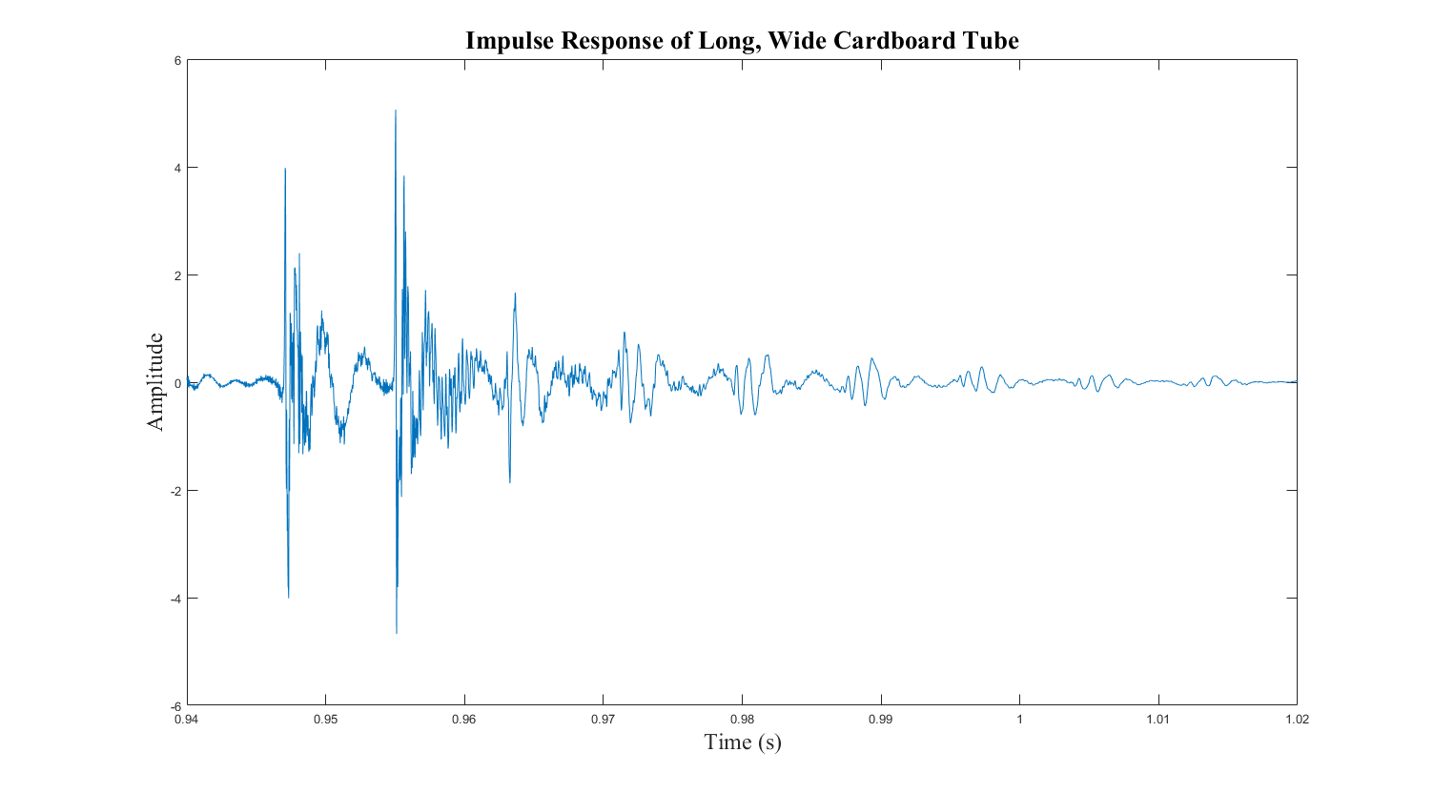
Length of a Cardboard Tube

Slide 13
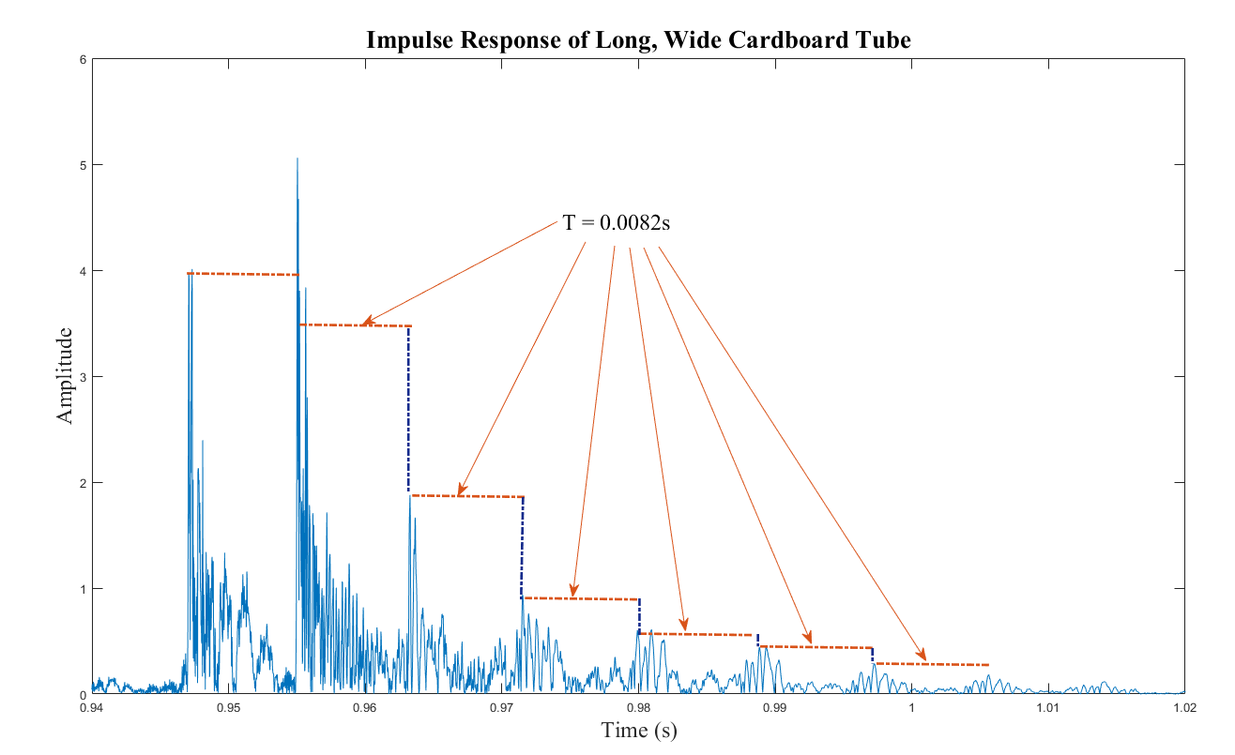
Length of a Cardboard Tube
2 * L = T * 343 m/s
L = 1.4 m

Slide 14
Length of a Cardboard Tube
2 * L = T * 343 m/s
L = 1.4 m
Actual Length:
1.39 m

Slide 15
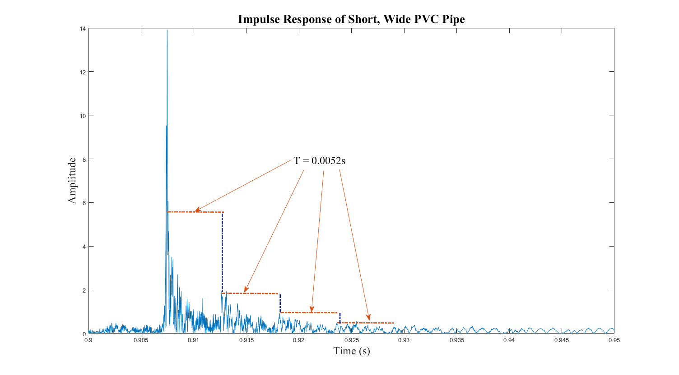
Length of a Short PVC Pipe
2 * L = T * 343 m/s
L = 0.89 m

Slide 16
Length of a Short PVC Pipe
2 * L = T * 343 m/s
L = 0.89 m
Actual Length:
0.865 m

Slide 17
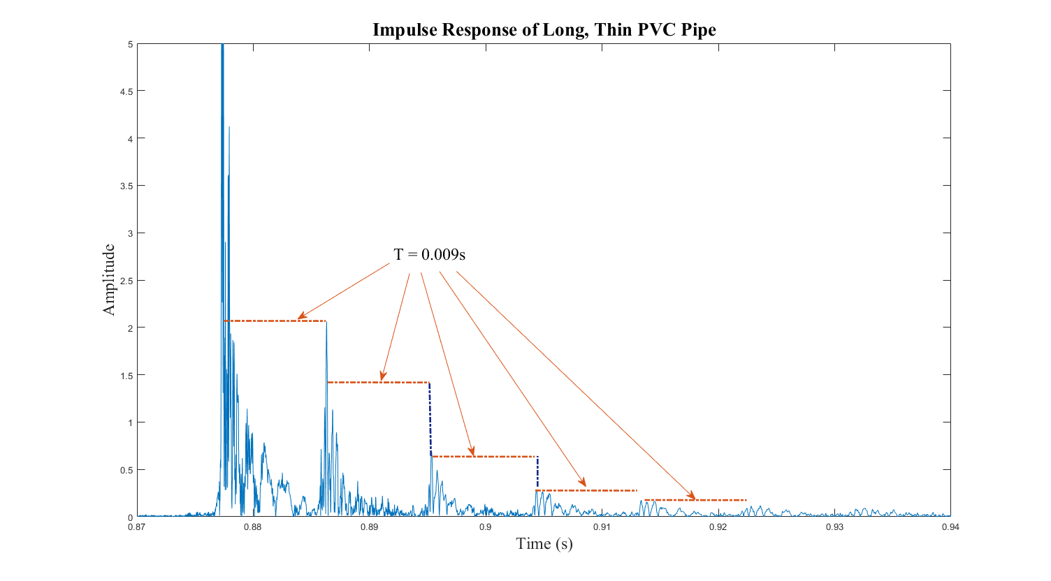
Length of a Long PVC Pipe
2 * L = T * 343 m/s
L = 1.54 m

Slide 18
Length of a Long PVC Pipe
2 * L = T * 343 m/s
L = 1.54 m
Actual Length:
1.52 m

Slide 19
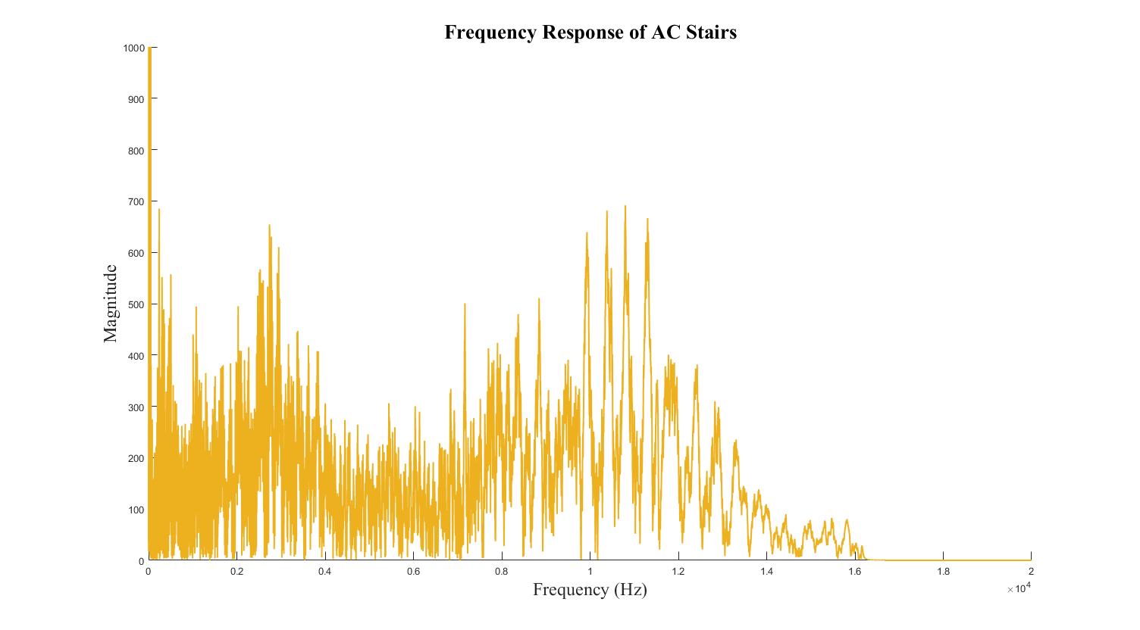
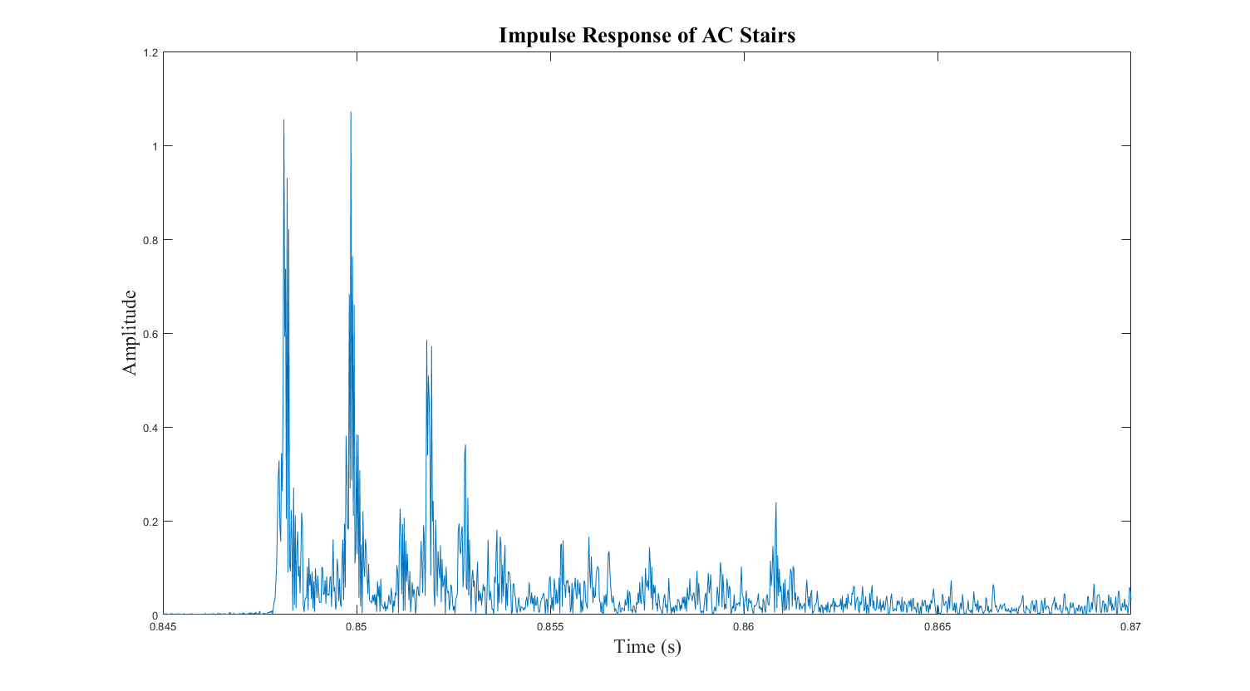
Impulse Responses of Spaces: AC Staircase
H(jw)
h(t)

Slide 20
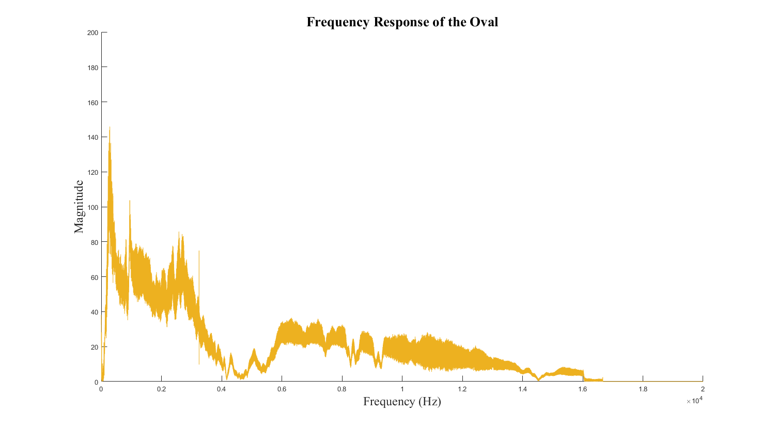
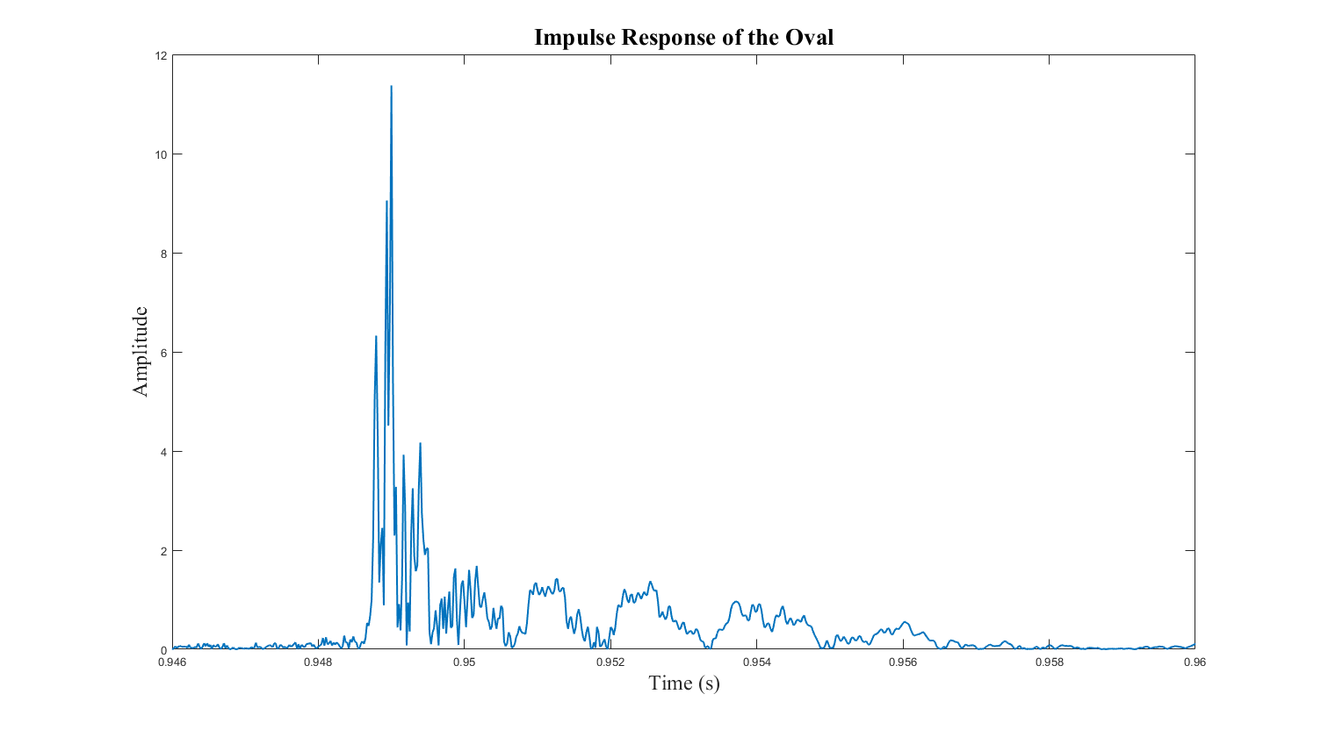
Impulse Responses of Spaces: The Oval
H(jw)
h(t)

Slide 21
Part 2: Convolve the Impulse Response with Sounds
Impulse
Response
Original
Sound
Sound in the space
h(t) * s(t) = s’(t)

Slide 22
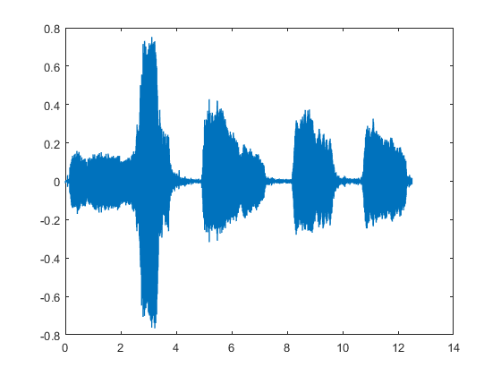
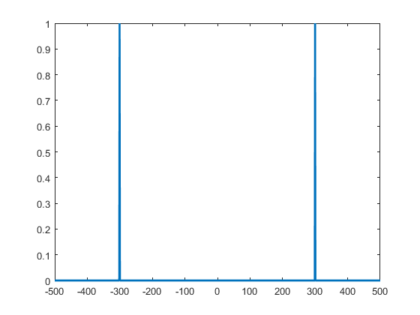
Effect of Impulse Responses on a Sound: Cosine
Original Dove
Create an impulse response from a cosine
(Frequency of 300 Hz)
H(jw)
Amplitude
Time (s)
Amplitude
Frequency (Hz)
Notes:
Include sounds

Slide 23
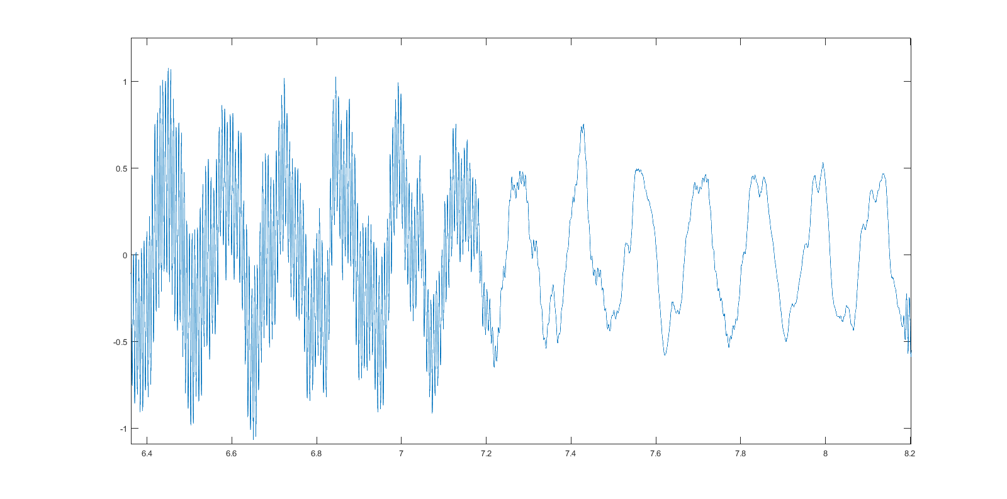
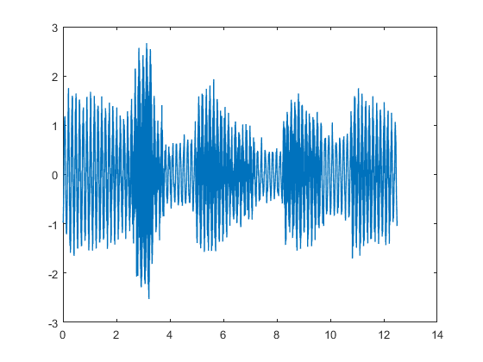
Effect of Impulse Responses on a Sound: Cosine
Original Dove
Create an impulse response from a cosine
(Frequency of 300 Hz)
y(t) zoomed in
Amplitude
Time (s)
Amplitude
New Sound
30Hz
300Hz
Amplitude
Time (s)
3kHz
Time (s)
Notes:
Include sounds

Slide 24
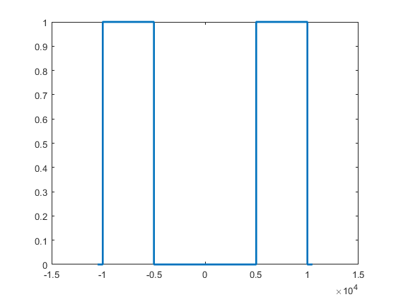
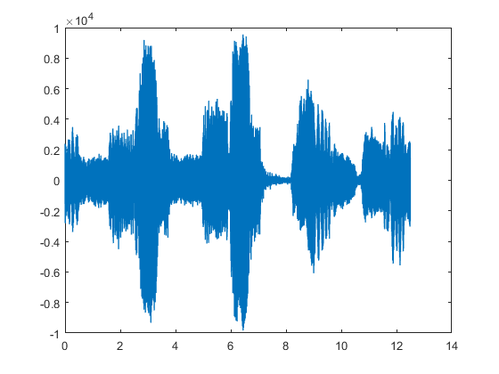
Effect of Impulse Responses on a Sound: Box
Original Dove
Create an impulse response from a box
(Frequency of 5kHz - 10kHz)
Amplitude
Time (s)
Amplitude
New Sound
Amplitude
Frequency (Hz)
Time (s)

Slide 25
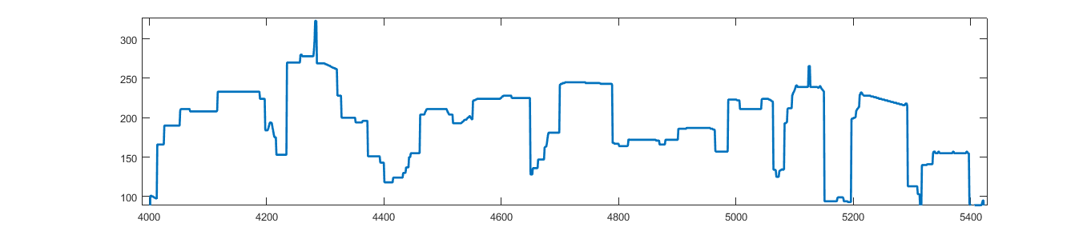
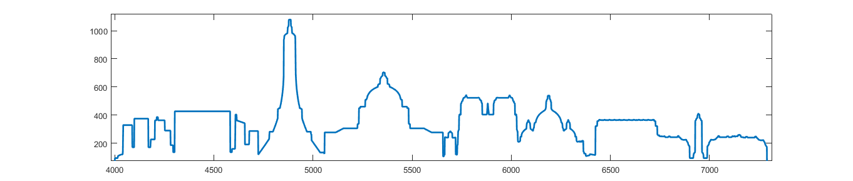
Convolving Doves with a Skyline
Boston
Amplitude
Frequency (Hz)
Paris
Amplitude
Frequency (Hz)
Notes:
Include sound

Slide 26
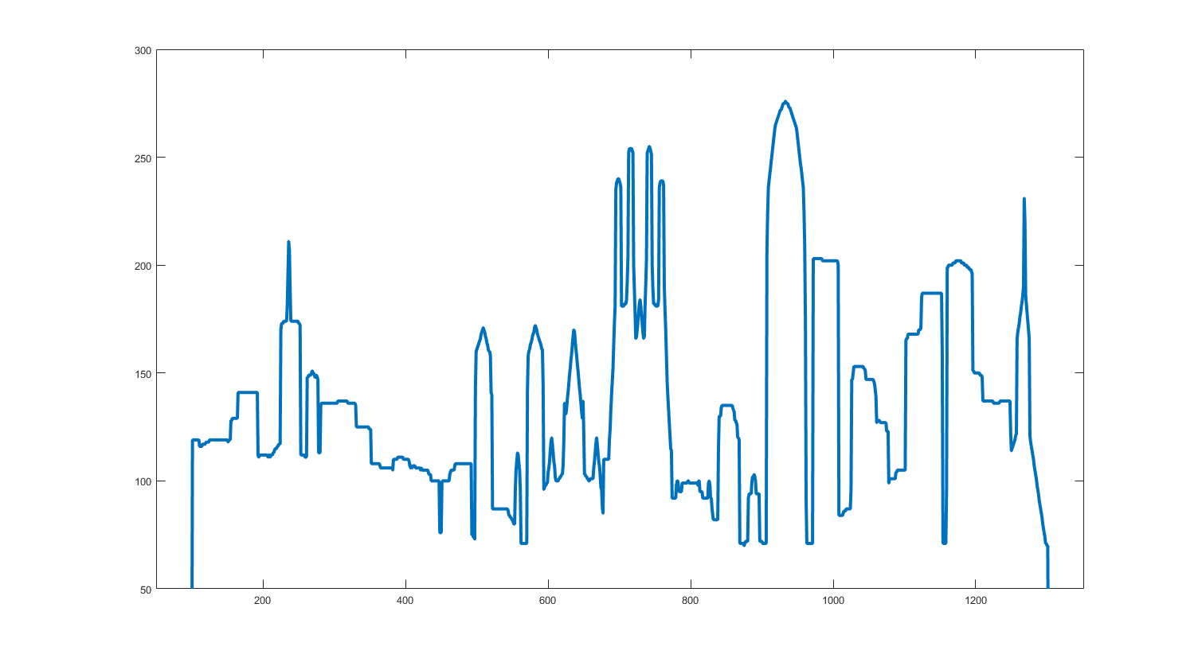
Convolving Delitos with a Skyline
Boston
Amplitude
Frequency (Hz)
Barcelona
Amplitude
Frequency (Hz)
Notes:
Include sound

Slide 27
Convolving Sound with a Space
Tube Pumpkin
Sphere AC Stairs
Middle of the O
AC Stairs
DOVE
DELITOS

